Slide 1
AI-Based Toxic Content and Potential Cyberbullying Detection
01
Machine Learning Based Text Classification
Based on the research paper: Cyberbullying Detection and Recognition with Type Determination Based on Machine Learning
Models: SVM, Logistic Regression, Naive Bayes, Random Forest
Project guide:
Team members:
Dr. Vikas Panthi
Program Chair, CSE-Core, SCOPEVIT Bhopal University
S. No. | Name | Registration Number
1 | SARAH SIDDIQUI | 25BCE10451
2 | MUDRIKA SHARMA | 25BCE10452
3 | K KUSHAL VARMA | 25BCE10447
4 | SUMEDHA KASHMIRA | 25BCE10764
5 | NAVRUP KAUR | 25BCE10350

Slide 2
Introduction
02
Social media platforms like Twitter generate huge volumes of text every day, and some of it is hateful, toxic or abusive.
Toxic content and cyberbullying can harm mental health, so detecting it early is important.
Manually checking so many tweets is slow, so automated machine learning detection is needed.
This project classifies tweets as Hatred / Toxic or Non-Hatred using text classification.
Tweets are cleaned, converted to numbers with TF-IDF, and classified with SVM, Logistic Regression, Naive Bayes and Random Forest.
Two combined models (SVM + LR and NB + LR) are built and compared with the individual models.
The work is based on the paper Cyberbullying Detection and Recognition with Type Determination Based on Machine Learning.

Slide 3
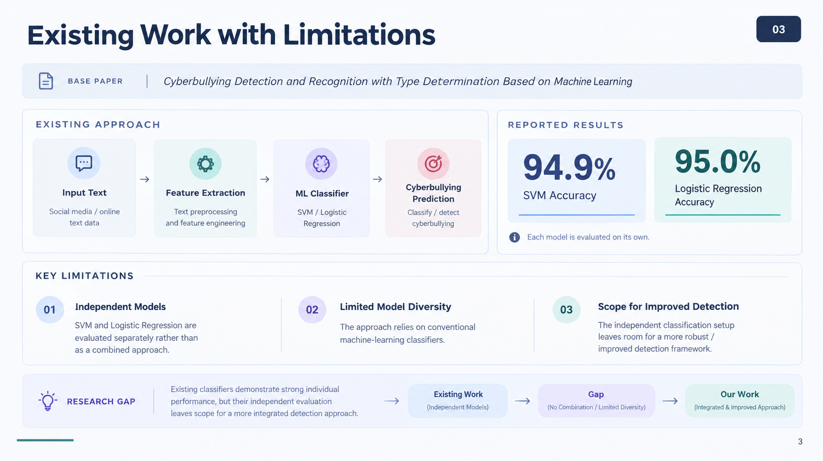
Existing Work with Limitations
03
Base paper: Cyberbullying Detection and Recognition with Type Determination Based on Machine Learning
The base paper uses machine learning classifiers for cyberbullying detection.
It reports SVM accuracy of 94.9% and Logistic Regression accuracy of 95%.
Each model is evaluated on its own.

Slide 4
Proposed Work and Methodology
04
Detect hateful/toxic content in tweets using machine learning.
Follow the general machine-learning approach described in the research paper.
Compare individual models and develop two combined models.
Final combined models: SVM + Logistic Regression and Naive Bayes + Logistic Regression.
Methodology: Preprocessing → TF-IDF → ML models → Evaluation → Model combination

Slide 5
Novelty of the Project
05
Instead of relying on one classifier, the project combines two models in the final prediction: SVM + Logistic Regression and Naive Bayes + Logistic Regression.
The two combined models are compared on accuracy and on technical measures: prediction time, learned parameters, model size, non-zero values and training time.
The comparison shows the trade-offs: SVM + LR is faster and smaller, while NB + LR trains faster.
Both combined models use the same TF-IDF features, so the comparison is fair.

Slide 6
Real Time Usage
06
A trained model can classify a new tweet or comment instantly. The predict_svm() and predict_logistic() functions clean the text, convert it with TF-IDF, and return the label.
It can be used in:
  Social media platforms to flag or filter abusive posts
  Comment moderation on forums, YouTube and news sites
  School and parental monitoring tools for cyberbullying alerts
  Online gaming and chat apps for toxic message detection
Prediction is fast (about 0.003 s for SVM + LR on the test set), which suits live use.

Slide 7
Hardware & Software Requirements
07
Software
Language: Python 3
Platform: Google Colab (used to write, run and test the code)
Libraries:
  pandas and NumPy for data handling
  NLTK for stopwords and the Porter stemmer
  scikit-learn for TF-IDF, SVM, Logistic Regression, Naive Bayes, Random Forest and metrics
  Matplotlib for plots
Dataset: labelled tweets CSV (train.csv, 31,962 tweets)
Browser: Google Chrome
Hardware
Laptop/computer with internet access.

Slide 8
Overall System Architecture Diagram
08
Preprocessing
Clean text, remove stopwords, stemming
ML Models
SVM, Logistic Regression, Naive Bayes, Random Forest
Combined Models
SVM + LR
NB + LR
Labelled Dataset
31,962 tweets
TF-IDF
26,409 features
Evaluation
Accuracy, Precision, Recall, F1
Input: tweet text → Output: Hatred / Toxic or Non-Hatred
Data split: 70% training (22,373 tweets) | 30% testing (9,589 tweets)

Slide 9
Literature Review
09
# | Paper / Authors (Year) | Method | Key Finding | Limitation
1 | Cyberbullying Detection and Recognition with Type Determination Based on Machine Learning (base paper) | TF-IDF features with SVM and Logistic Regression | SVM: 94.9% accuracy, Logistic Regression: 95% accuracy | Models are used individually and not combined, and accuracy is the main metric
2 | Reynolds et al. (2011), Using Machine Learning to Detect Cyberbullying | Language-based features with ML classifiers | Showed that cyberbullying can be detected automatically from text | Relies on a limited set of offensive words
3 | Dinakar et al. (2011), Modeling the Detection of Textual Cyberbullying | Separate classifiers for topics such as appearance and intelligence | Topic-specific classifiers worked better than one general classifier | Needs a labelled dataset for each topic
4 | Waseem & Hovy (2016), Hateful Symbols or Hateful People? | Character n-gram features with Logistic Regression on tweets | Character n-grams gave strong results for hate speech detection | Annotation is subjective and the dataset is small
5 | Davidson et al. (2017), Automated Hate Speech Detection and the Problem of Offensive Language | TF-IDF with Logistic Regression and SVM | Hate speech is hard to tell apart from merely offensive language | Misclassifies offensive but non-hateful tweets

Slide 10
Module Description (1/2)
10
Dataset
Text Preprocessing
TF-IDF Feature Extraction
Labelled dataset: 31,962 tweets
70% training data: 22,373 tweets
30% testing data: 9,589 tweets
Test set kept unseen during training
Predictions evaluated against actual test labels
Remove usernames and URLs
Remove punctuation and special characters
Remove stopwords
Apply stemming
Purpose: reduce unnecessary text and prepare tweets for feature extraction
Converts text into numerical features
Fitted on training data, then used to transform test data
Training shape: 22,373 × 26,409
Testing shape: 9,589 × 26,409
Total TF-IDF features: 26,409

Slide 11
Module Description (2/2)
11
Individual ML Models
Evaluation
Final Combined Models
Logistic Regression
SVM (Linear SVM)
Naive Bayes
Random Forest
All compared on the same TF-IDF features
Models trained on 22,373 training tweets
Predict labels for unseen 9,589 test tweets
Accuracy = Correct / Total Predictions × 100
Precision = TP / (TP + FP)
Recall and F1-score also used
Model 1: SVM + Logistic Regression
Model 2: Naive Bayes + Logistic Regression
Purpose: use more than one classifier in the final prediction approach
Both use the same TF-IDF feature representation

Slide 12
Module Work Flow Explanation
12
1
Load the labelled tweet dataset (31,962 tweets).
2
Clean tweets: remove usernames, URLs, punctuation, stopwords; apply stemming.
3
Split data: 70% training (22,373) and 30% testing (9,589).
4
Fit TF-IDF on training data and transform test data (26,409 features).
5
Train SVM, Logistic Regression, Naive Bayes and Random Forest on training tweets.
6
Predict labels for unseen test tweets and evaluate (accuracy, precision, recall, F1).
7
Combine predictions (SVM + LR, NB + LR) and compare technically.

Slide 13
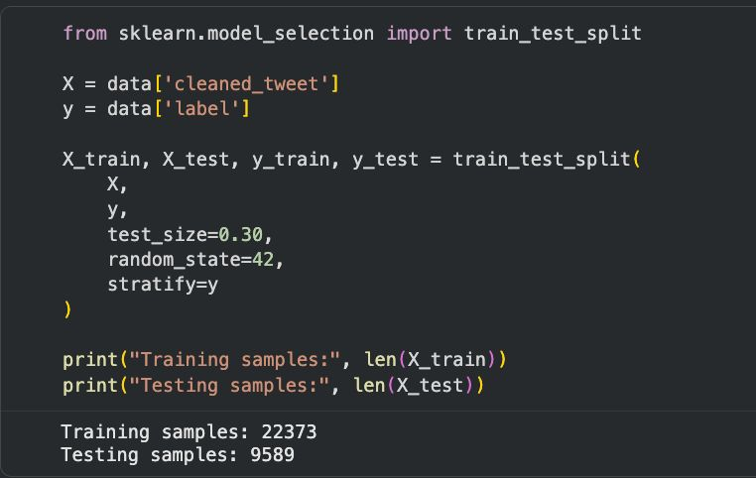
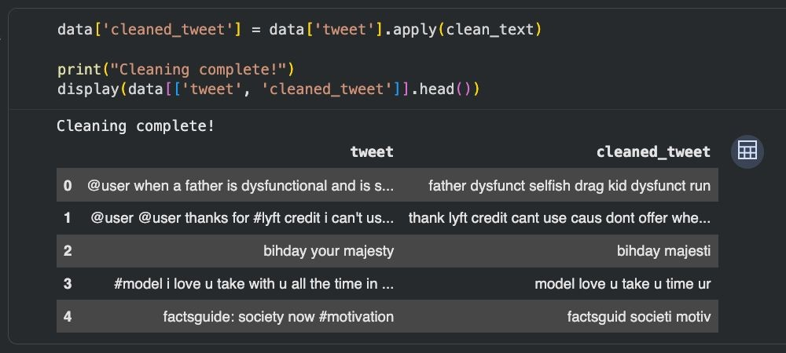
Implementation and Coding (1/3)
13
Text preprocessing
Train/test split and TF-IDF
def clean_text(text):
text = str(text).lower()
text = re.sub(r'@\w+', '', text)
text = re.sub(r'http\S+|www\S+', '', text)
text = re.sub(r'[^a-zA-Z\s]', '', text)
text = re.sub(r'\s+', ' ', text).strip()
words = text.split()
words = [stemmer.stem(w) for w in words
if w not in stop_words]
return ' '.join(words)
df['clean_tweet'] = df['tweet'].apply(clean_text)

Slide 14
Implementation and Coding (2/3)
14
Model training and prediction
Evaluation (for each model)
lr = LogisticRegression(max_iter=1000)
svm = LinearSVC()
nb = MultinomialNB()
rf = RandomForestClassifier(
n_estimators=100,
random_state=42, n_jobs=-1)
lr.fit(X_train_tfidf, y_train)
svm.fit(X_train_tfidf, y_train)
nb.fit(X_train_tfidf, y_train)
rf.fit(X_train_tfidf, y_train)
lr_pred = lr.predict(X_test_tfidf)
svm_pred = svm.predict(X_test_tfidf)
nb_pred = nb.predict(X_test_tfidf)
rf_pred = rf.predict(X_test_tfidf)
accuracy_score(y_test, lr_pred)
precision_score(y_test, lr_pred)
recall_score(y_test, lr_pred)
f1_score(y_test, lr_pred)
confusion_matrix(y_test, lr_pred)

Slide 15
Implementation and Coding (3/3)
15
Combined models
New text prediction
# SVM + Logistic Regression
svm_lr_pred = []
for s, l in zip(svm_pred, lr_pred):
if s == l:
svm_lr_pred.append(s)
else:
svm_lr_pred.append(l) # use LR
# Naive Bayes + Logistic Regression
nb_lr_pred = []
for n, l in zip(nb_pred, lr_pred):
if n == l:
nb_lr_pred.append(n)
else:
nb_lr_pred.append(l) # use LR
def predict_svm(text):
cleaned = clean_text(text)
vector = tfidf.transform([cleaned])
prediction = svm.predict(vector)[0]
if prediction == 1:
return "Hatred / Toxic"
else:
return "Non-Hatred"
# predict_logistic() is the same, using lr
print(predict_svm("I hate you"))

Slide 16
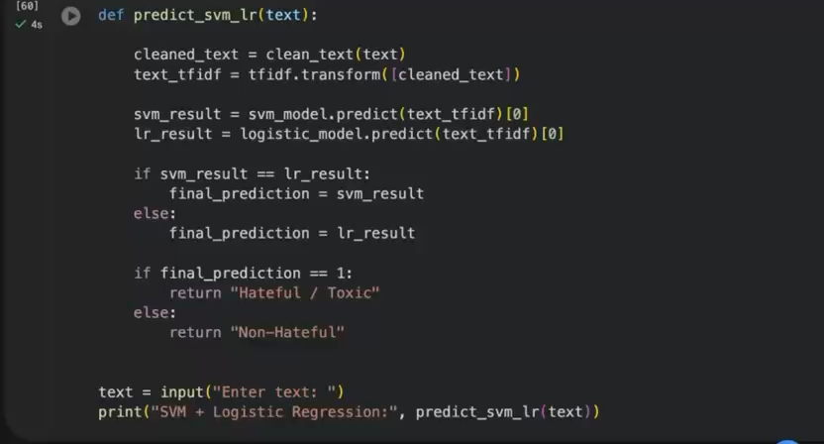
Demo Video
16

Slide 17
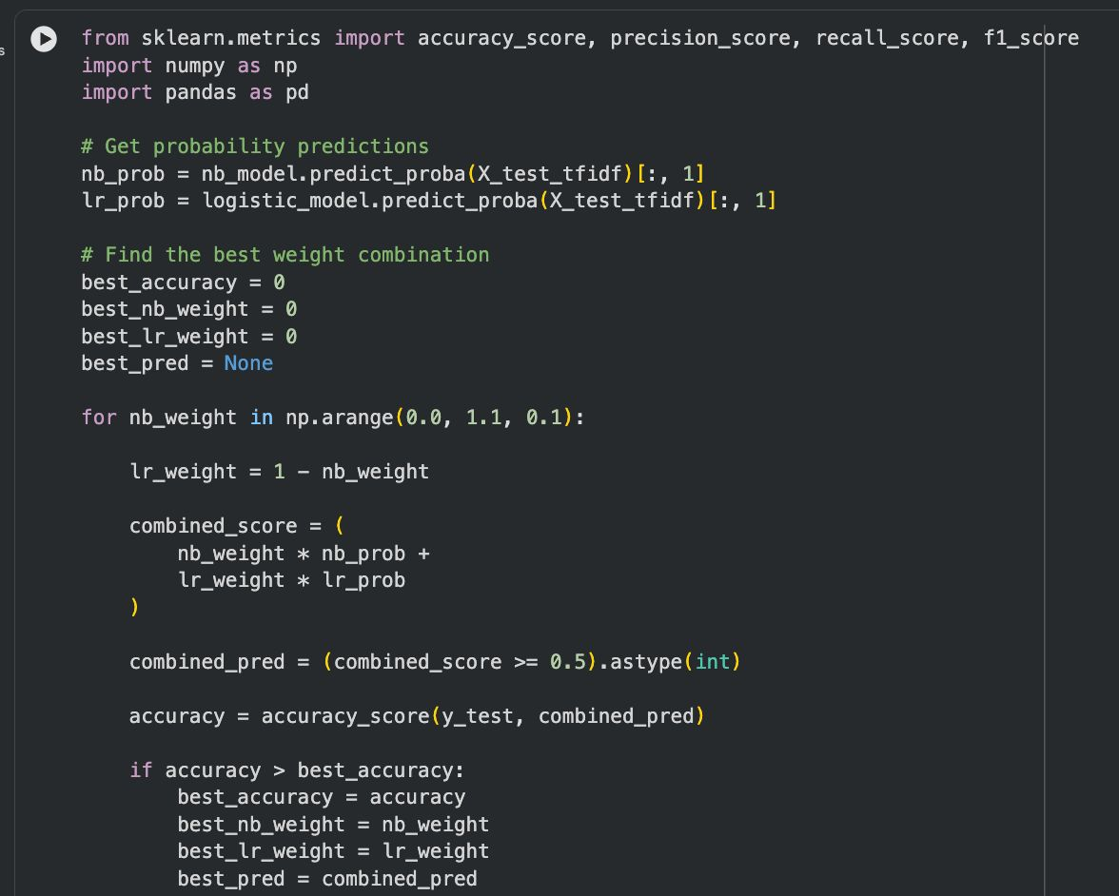
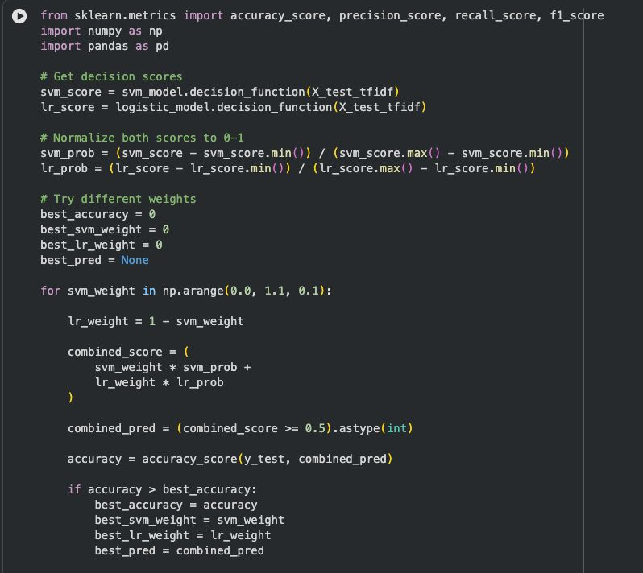
Snapshots of the Project
17

Slide 18
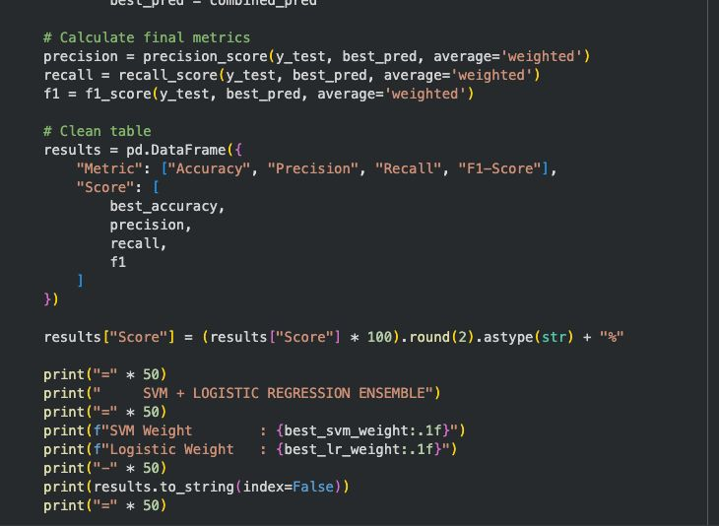
Snapshots of the Project

Slide 19
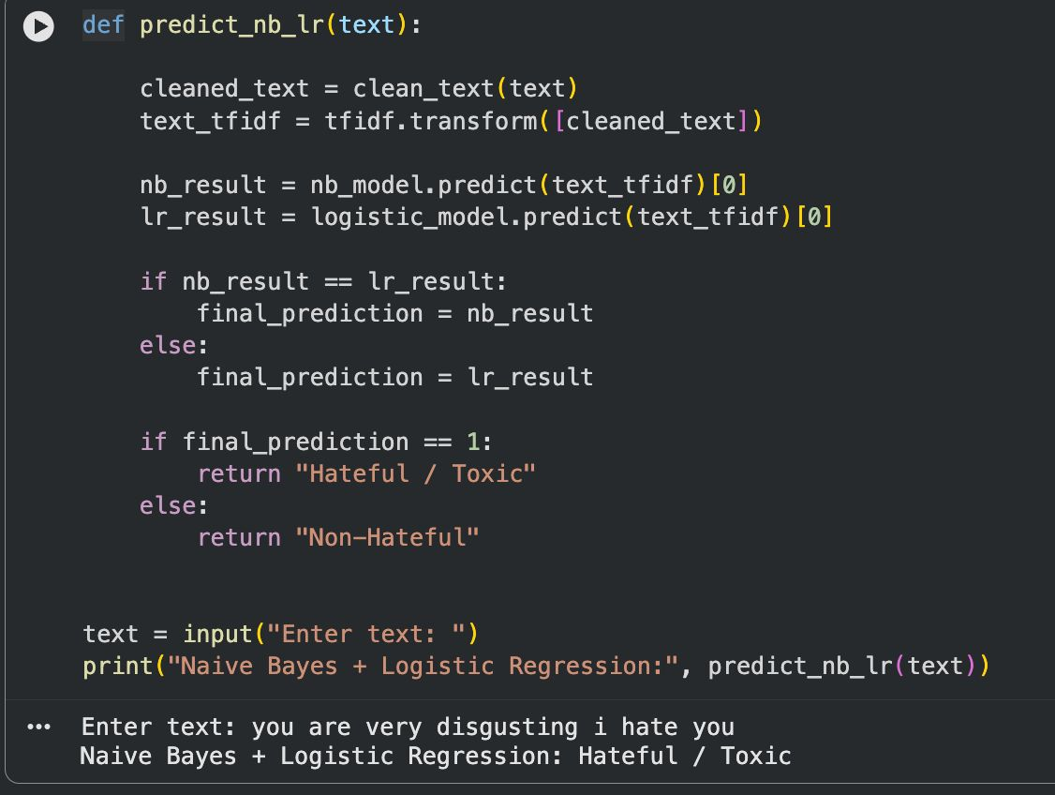
Testing
18
How evaluation works
Models trained using the 22,373 training tweets
Predict labels for the unseen 9,589 test tweets
Accuracy = Correct Predictions / Total Predictions × 100
Precision = TP / (TP + FP)
Recall and F1-score also used to understand classification performance

Slide 20
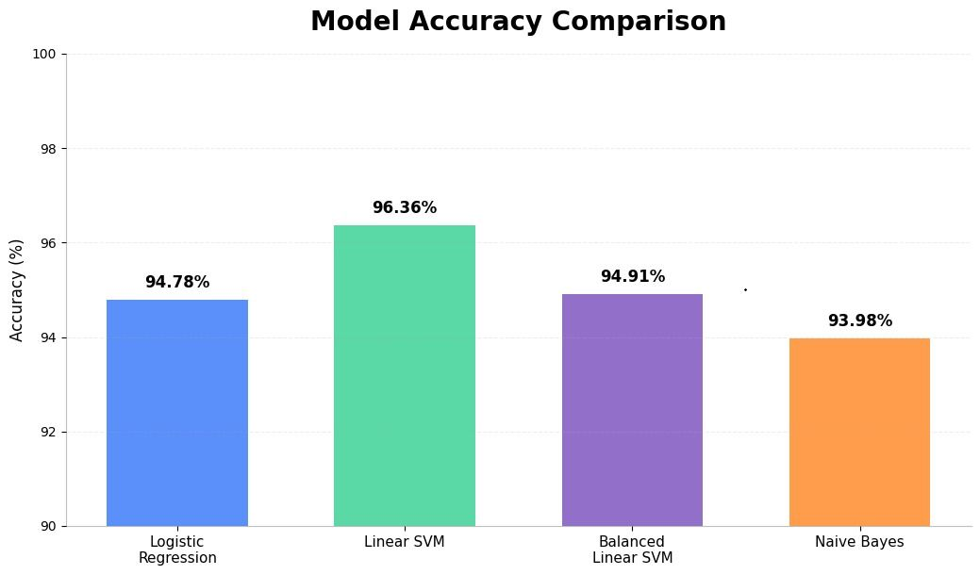
Result and Discussion: Individual Models
19
Model | Accuracy | Precision | Recall | F1 Score
Logistic Regression | 94.78% | 90.95% | 28.38% | 43.26%
Linear SVM | 96.36% | 86.99% | 56.61% | 68.59%
Balanced Linear SVM | 94.91% | 62.19% | 70.13% | 65.92%
Naive Bayes | 93.98% | — | — | —
Research paper accuracy
SVM: 94.9%
Logistic Regression: 95%

Slide 21
Result and Discussion: Technical Comparison
20
Parameters | SVM + LR | NB + LR | Result
Prediction Time (sec) | 0.0029 | 0.0087 | SVM + LR
TF-IDF Features | 26,409 | 26,409 | Same
Learned Parameters | 52,818 | 79,227 | SVM + LR
Model Size (MB) | 0.40 | 1.01 | SVM + LR
TF-IDF Sparsity (%) | 99.97 | 99.97 | Same
Non-Zero Learned Values | 42,507 | 79,227 | SVM + LR
Training Time (sec) | 0.903571 | 0.755459 | NB + LR

Slide 22
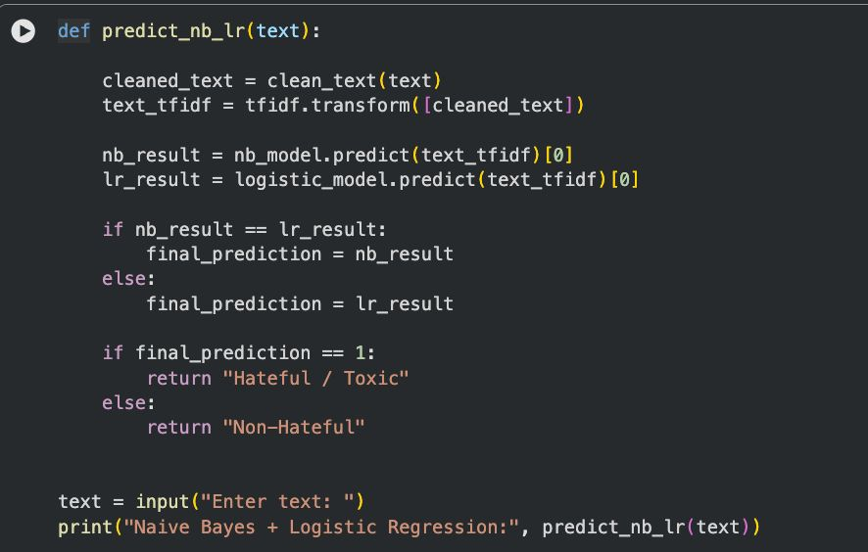
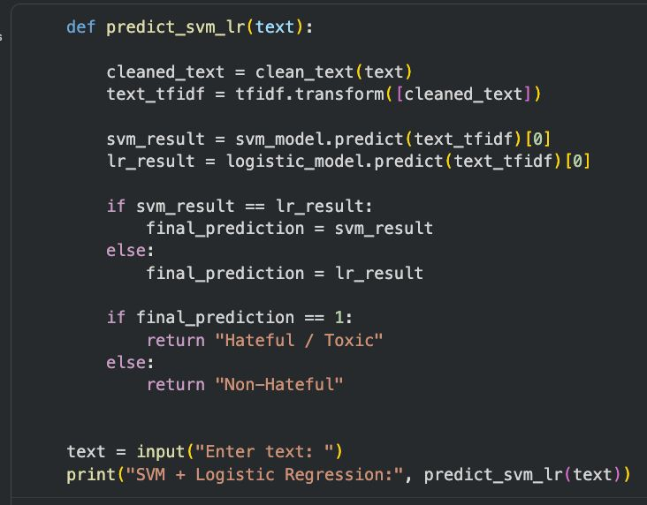
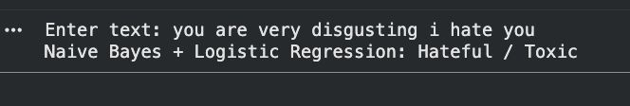

Result and Discussion: Input and Output
21
Input
Output

Slide 23
Conclusion
22
A complete text-classification pipeline was developed: preprocessing → TF-IDF → ML models → evaluation → model combination.
SVM and Logistic Regression were combined as one final model.
Naive Bayes and Logistic Regression were combined as the second final model.
The final comparison shows that each combined model has different technical strengths.
The project demonstrates how machine learning can be applied to toxic/hateful text detection.

